Slide 1
JAN23
Tracking ASEAN’s Happiness Score:
Before and After Covid-19 Outbreak
A research by Group O, section Hamburg.

Slide 2




Team Members
Project Lead
Ellizartama Taufik Hadimulyo
Data Cleaning & Analysis
Ridho Muhammad Syahputra
Data Analysis & Visualization
Dina Kurniawati
Data Visualization
Satriyo Sidik Ibrahim

Slide 3

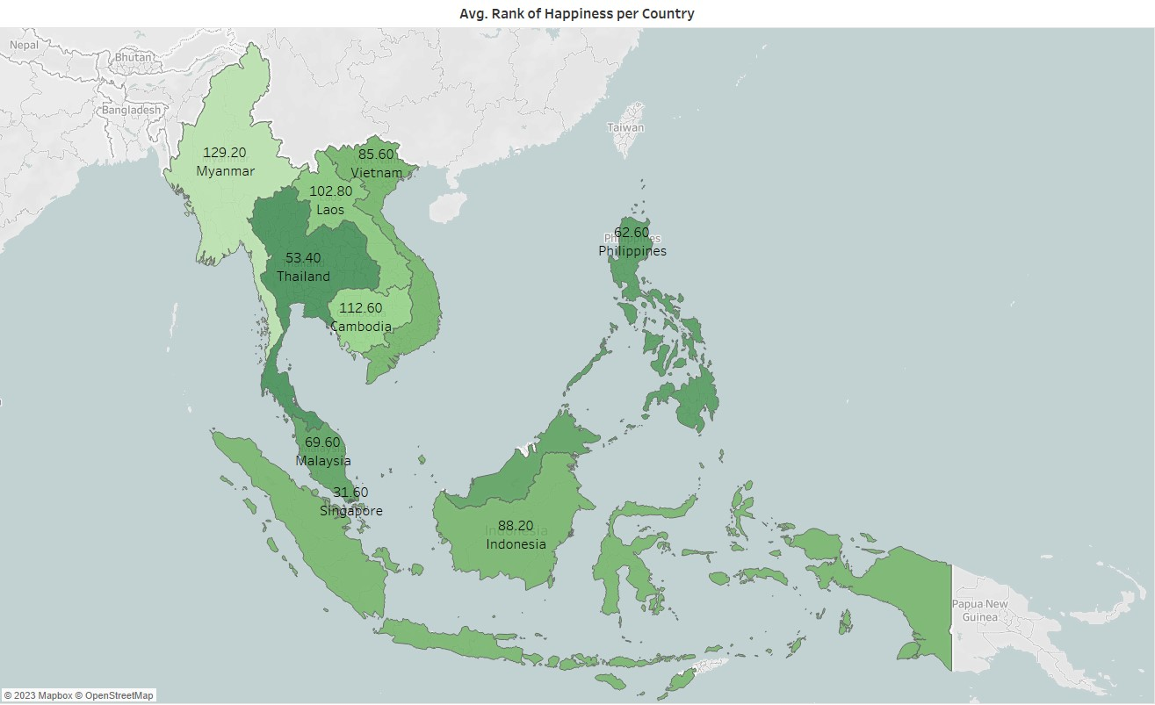
Average Rank per Country
As the world grappled with the Covid-19 outbreak in 2020, the ASEAN countries were not spared from its impact on the overall quality of life. Thus, this research aims to urge the respective authorities to implement policies that prioritize the enhancement of happiness score in their respective nations.
Notes:
Warnanya dikasitau utk membedakan rankingnya
Rankingnya relatif sama kami mencoba mengggali lebih dalam terkait kebijakannya

Slide 4
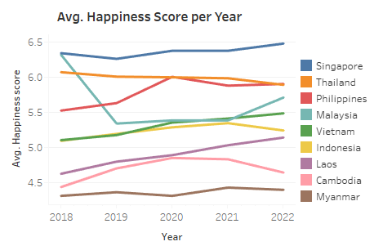
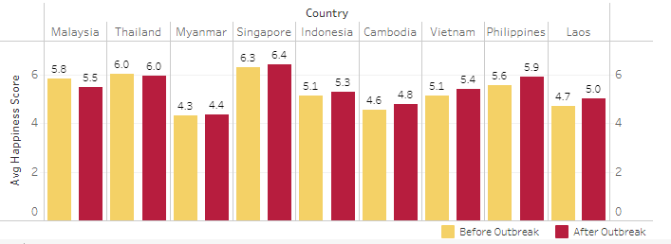
Avg Happiness Score Before-After Outbreak
These visualizations indicate that several countries are experiencing the decline in happiness score from 2018 to 2022.
2018-2019 = Before Outbreak | 2020-2022 = After Outbreak
Notes:
Before sama after bisa dilihat dr bar chart terlihat penurunannya, walaupun di line chart tdk begitu signifikan

Slide 5
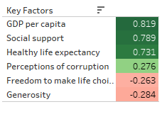
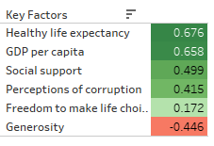
BEFORE OUTBREAK
GDP PER CAPITA
SOCIAL SUPPORT
HEALTHY LIFE EXPECTANCY
AFTER OUTBREAK
GDP PER CAPITA
SOCIAL SUPPORT
HEALTHY LIFE EXPECTANCY
PERCEPTIONS OF CORRUPTION
GENEROSITY
The decline in happiness score is related to several key factors that differ between before and after the Covid-19 outbreak. The graphs above show the correlation of happiness score to its key factors.
Notes:
Penurunan growth happiness score disertai faktor penyerta sebelum dan setelah pandemi yang berbeda dimana faktor setelah lebih banyak lagi yang harus diperhatikan (5 faktor) ketimbang sebelum pandemi

Slide 6
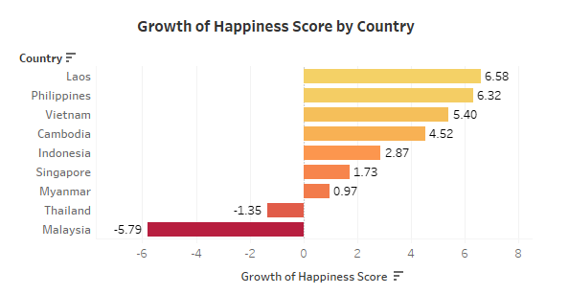
Overview of 3 ASEAN countries with the lowest growth of happiness score in relation to their happiness condition before and after Covid-19 outbreak.
Notes:
Walaupun secara tingkat ASEAN terdapat kondisi umum yang telah dijelaskan sebelumnya tetapi negara - negara yang berada pada bottom 3 memiliki faktor kunci yang lebih khusus (dapat dilihat pada gambar tabel)
18-19 Sebelum, 20-22 sesudah

Slide 7
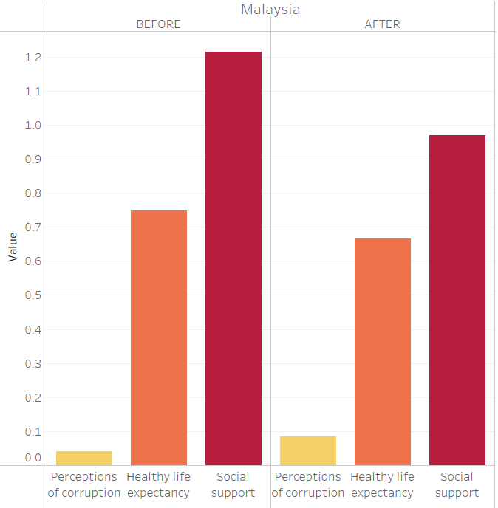
MALAYSIA should focus on improving 3 key factors to enhance its happiness score:
PERCEPTIONS OF CORRUPTION
HEALTHY LIFE EXPECTANCY
SOCIAL SUPPORT
Notes:
Untuk thailand sendiri tampak bahwa harus lebih fokus pada bidang … , …., dan … sehingga kebijakan yang harus diperhatikan seperti ….

Slide 8
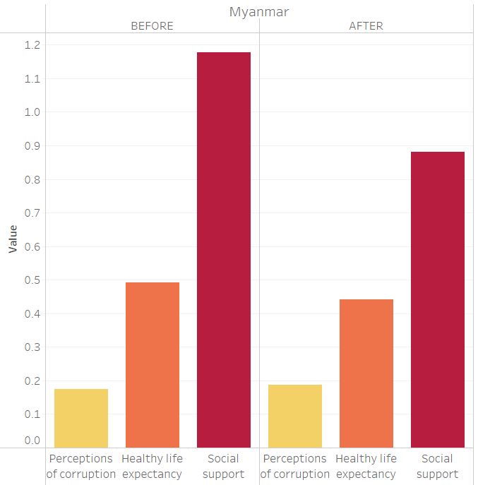
MYANMAR should focus on improving 3 key factors to enhance its happiness score:
PERCEPTIONS OF CORRUPTION
HEALTHY LIFE EXPECTANCY
SOCIAL SUPPORT
Notes:
Untuk thailand sendiri tampak bahwa harus lebih fokus pada bidang … , …., dan … sehingga kebijakan yang harus diperhatikan seperti ….

Slide 9
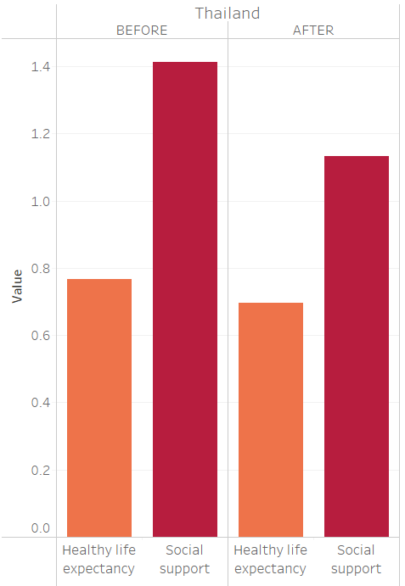
THAILAND should focus on improving 2 key factors to enhance its happiness score:
HEALTHY LIFE EXPECTANCY
SOCIAL SUPPORT
Notes:
Untuk thailand sendiri tampak bahwa harus lebih fokus pada bidang … , …., dan … sehingga kebijakan yang harus diperhatikan seperti ….

Slide 10
RECOMMENDATIONS
To improve low happiness scores, countries must implement appropriate policies based on key factors that affect their society. Therefore, governments must conduct careful evaluations and consider effective policies that are tailored to the challenges faced by their society.
PERCEPTIONS OF CORRUPTION
Governments should be transparent and accountable in their policies and practices to increase public trust.
SOCIAL SUPPORT
Promoting community engagement and social programs that strengthen social ties.
HEALTHY LIFE EXPECTANCY
Improving healthcare systems, reducing pollution, and promoting a healthy lifestyle.
Notes:
Sebut saja itu jaminan kesehetan, bisa bilang untuk lebih diperbaiki

Slide 11
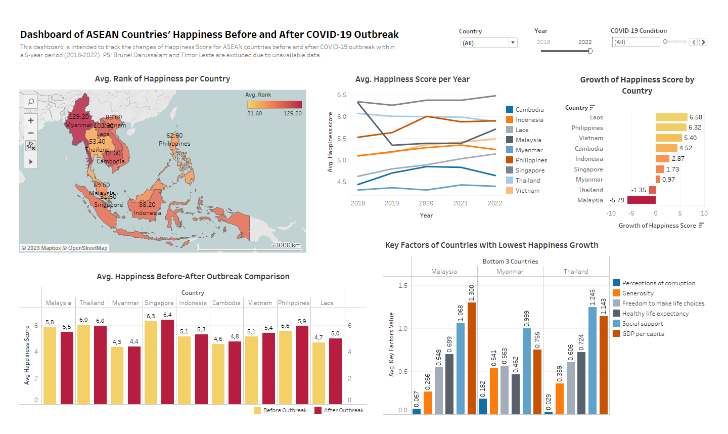
Click here to see the interactive dashboard
Notes:
Limitasi data, Brunei sm timor leste tdk tersedia datanya, boleh juga ditunjuk cursornya ke sub title di dashboard

Slide 12
"Basically, happiness must be created, in this case, policies towards key factors can be a way to get there."
THANK YOU

Slide 13
APPENDIX
Data
Script

